Slide 1
Unit 66 - Task 2
Salford City College – Future Skills
By joseph roper

Slide 2
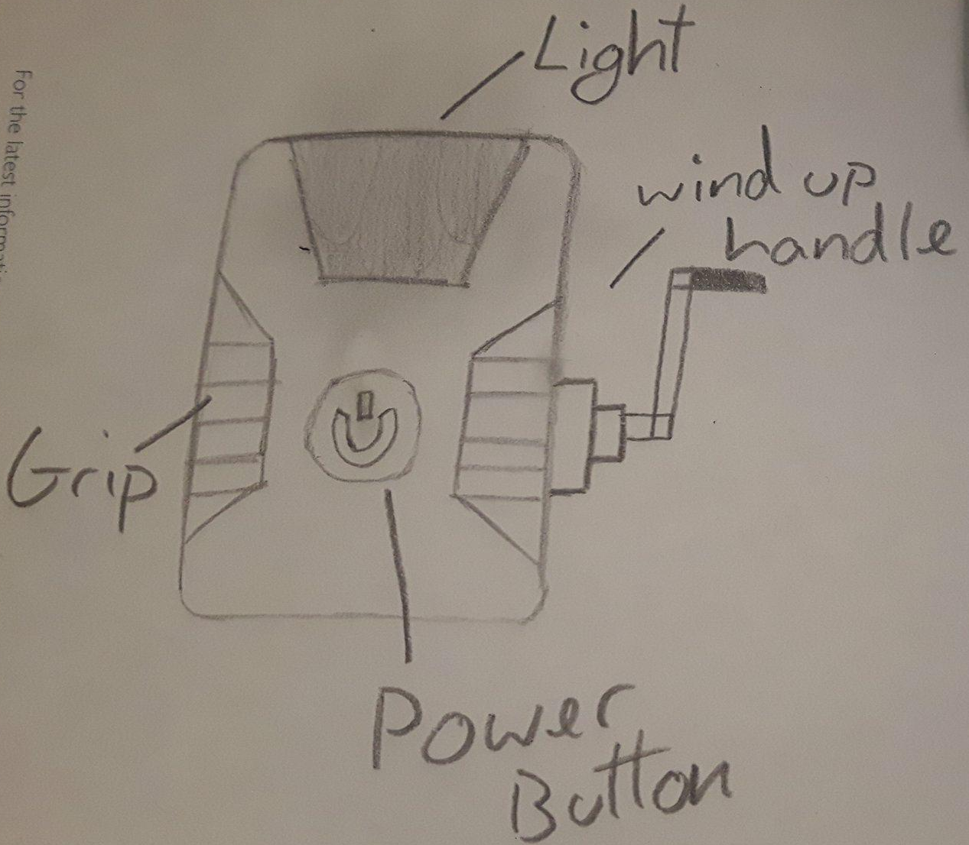
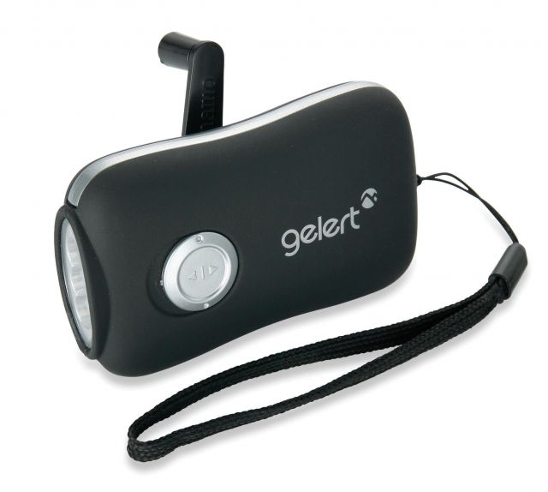
Model 1 – Concept/Design
For my first model I decided one survival item you would want while stuck on an island is a wind up torch that could last forever, providing light to keep you safe from predators at night. This model is suitable for all ages as it does not contain any blood or explicit images. The torch will have rubber grips on the side with a wind up handle and a power button in the middle.

Slide 3
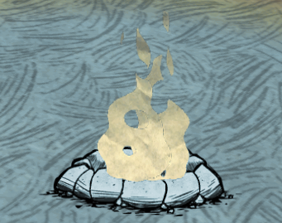
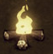
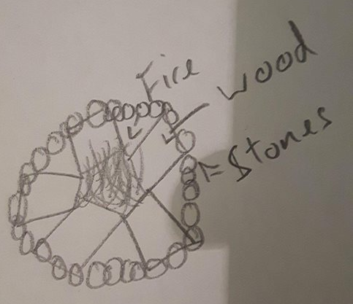
Model 2 – Concept/Design
For my second model I decided one survival item you would want while stuck on an island is a fire pit which would provide me with heat and a means to cook food and scare off predators. This model is suitable for all ages as it does not contain any blood or explicit images. For a reference I looked at both of the campfire models in the game Don’t Starve making my campfire a mixture of both with logs in the middle and stones on the outside.

Slide 4
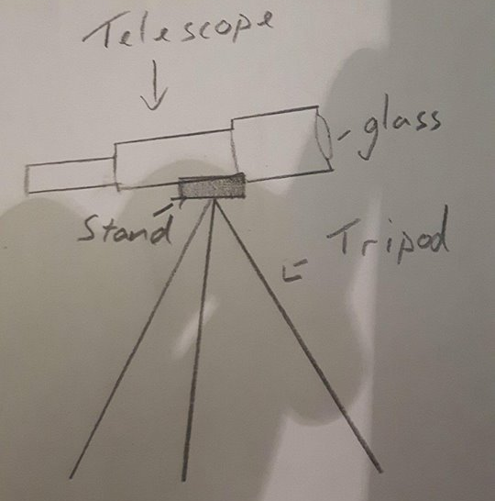

Model 3 – Concept/Design
My third design is a telescope as if I was stuck on a survival island I’d want a telescope so I would be able to look further out in the distance to hopefully see a ship coming in so I could make a smoke signal to aware the captain that I need saving. This model is suitable for all ages as it does not contain any blood or explicit images. The telescope will be made out of wood for example the tripod with the tips being made out of gold. However the gold and wood will look tattered and damaged like it’s just came out of a shipwreck.

Slide 5
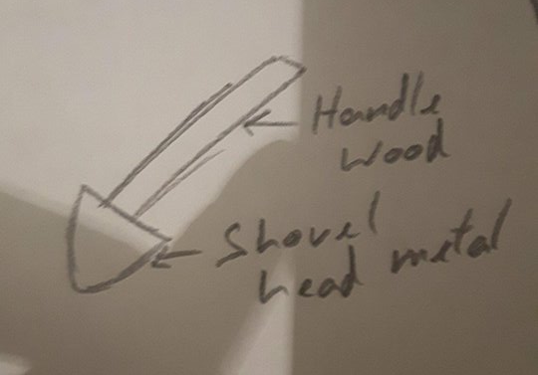
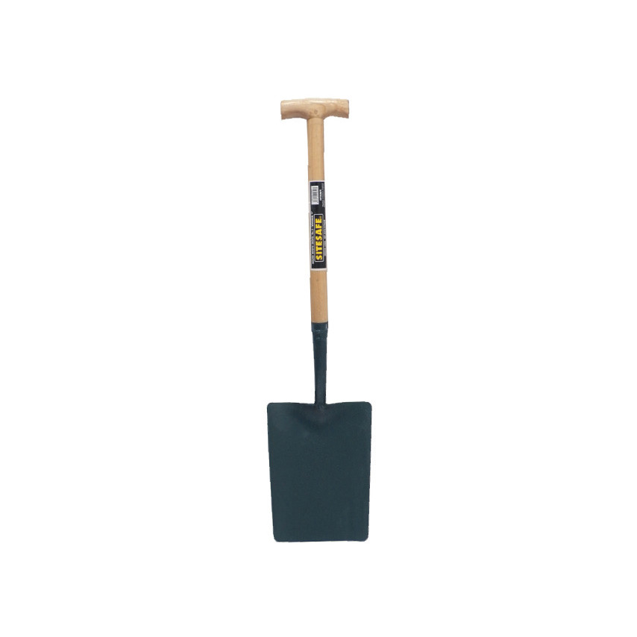
Model 4 – Concept/Design
For my fourth model I decided one survival item you would want while stuck on an island is a shovel that could be used to dig up dirt to build a mud hut for shelter. This model is suitable for all ages as it does not contain any blood or explicit images.

Slide 6
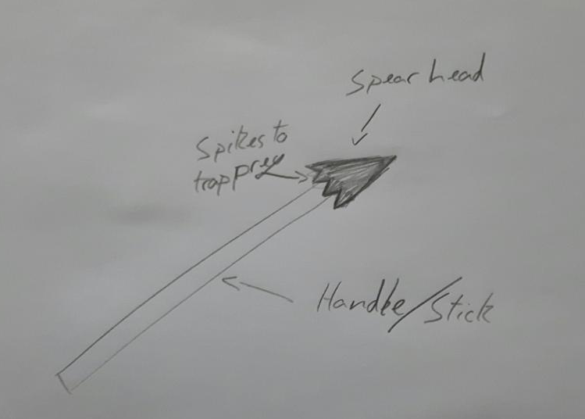
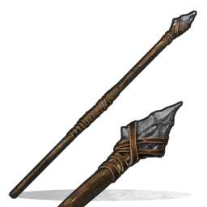
Model 5 – Concept/Design
For my fifth model I decided one survival item you would want while stuck on an island is a spear which can be used to hunt animals for food giving the distance I would want from an animal to feel safe while attacking. This model is suitable for all ages as it does not contain any blood or explicit images.

Slide 7
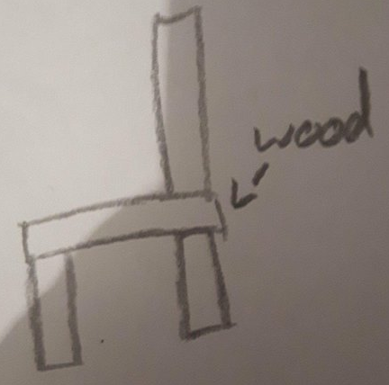
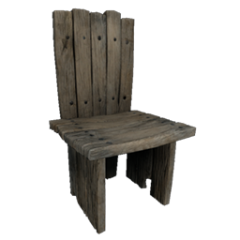
Model 6 – Concept/Design
For my sixth model I decided one survival item you would want while stuck on an island is a chair just so that you could have a chance to sit and relax while worrying about your oncoming death. This model is suitable for all ages as it does not contain any blood or explicit images.

Slide 8
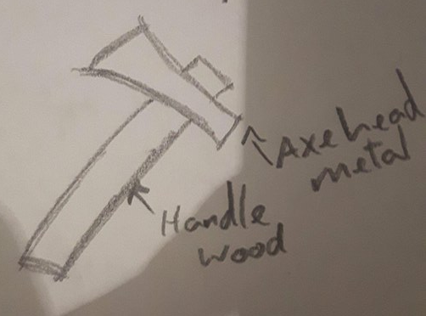
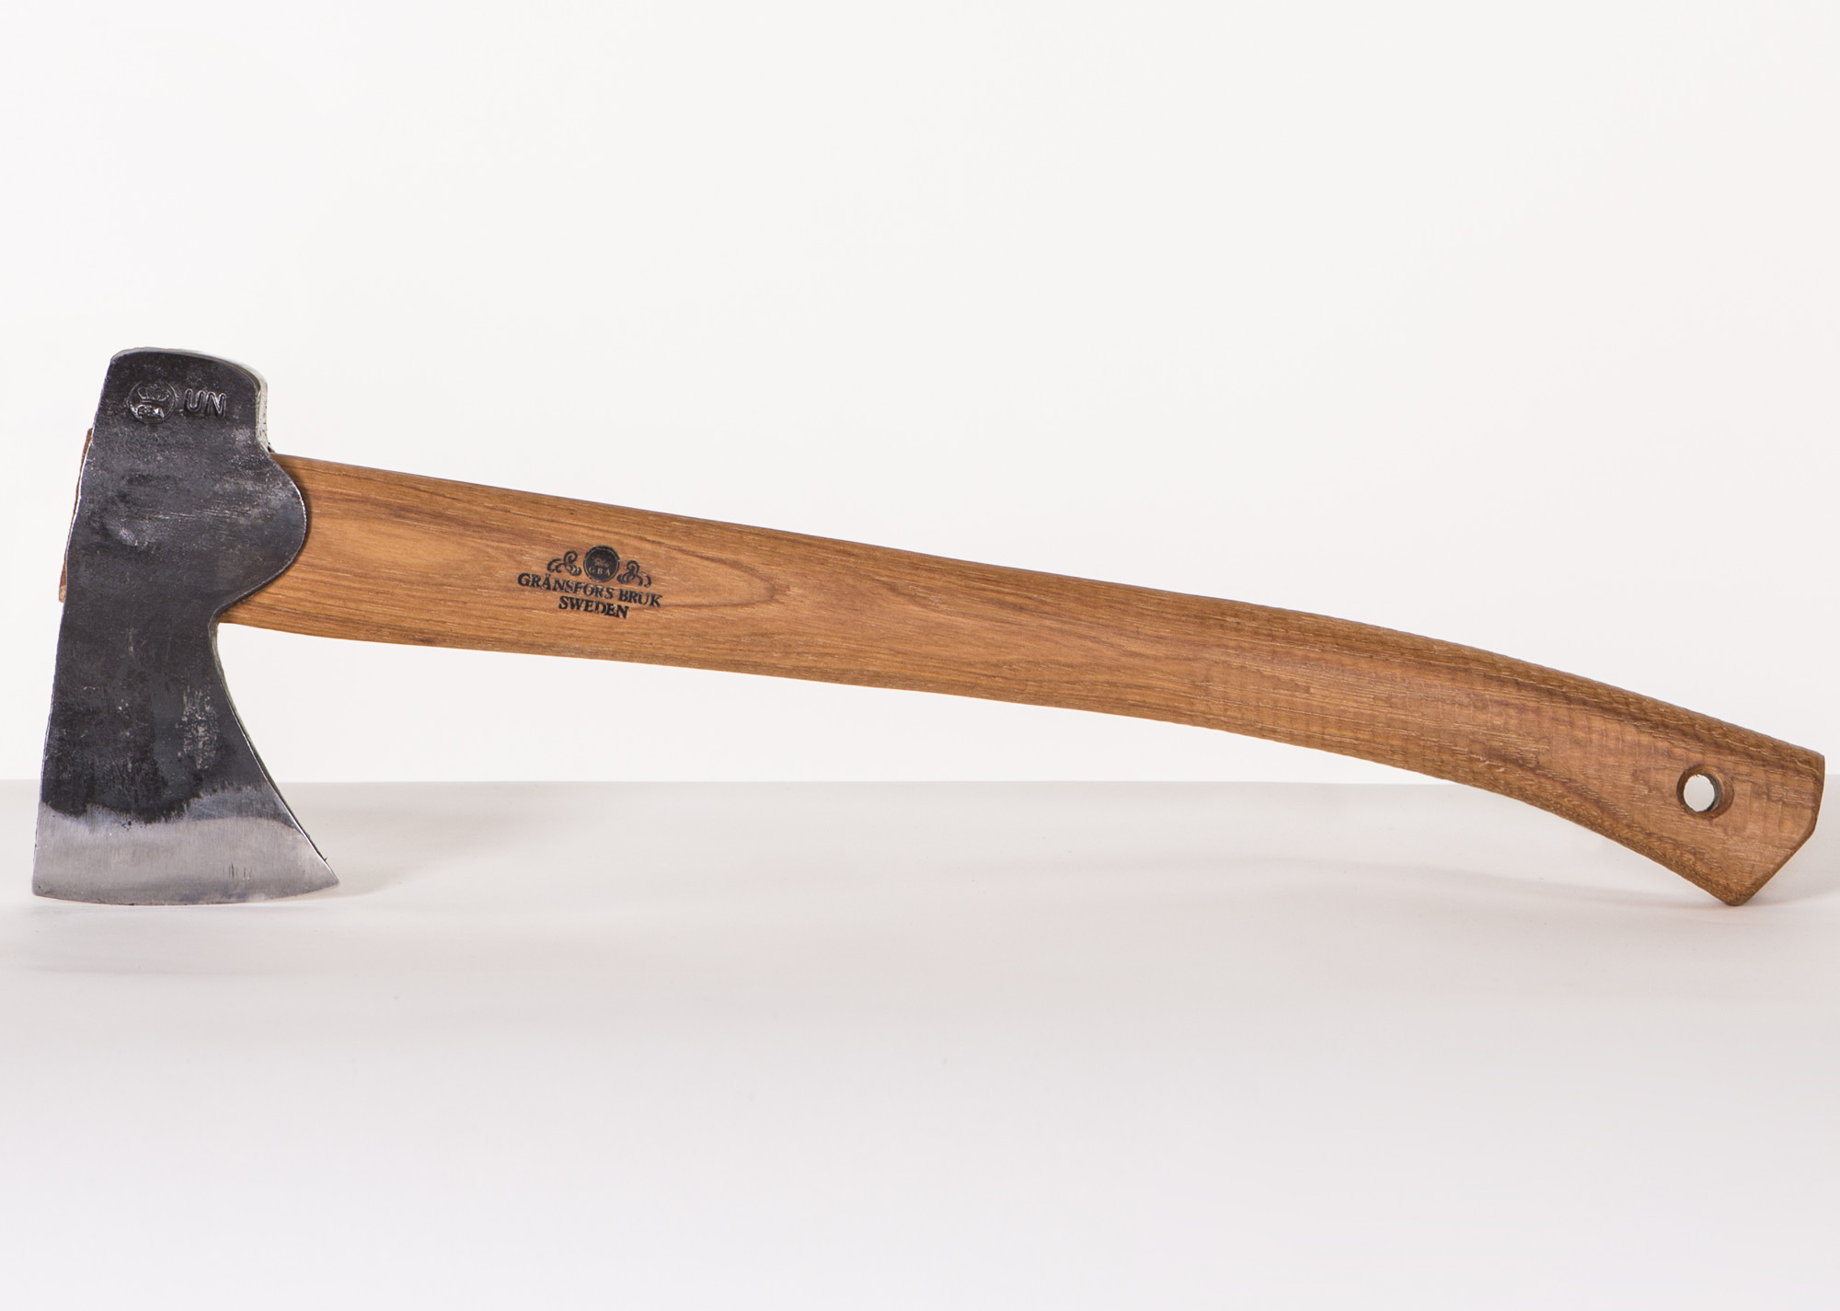
Model 7 – Concept/Design
For my seventh model I decided one survival item you would want while stuck on an island is a axe to cut down trees for a shelter and fire wood. This model is suitable for all ages as it does not contain any blood or explicit images.

Slide 9
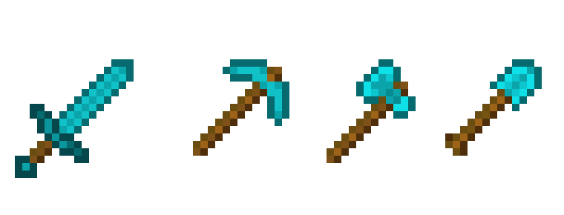
Conclusion
Throughout this assignment I have thought of 7 ideas for 3D models which I will later create. During the creation process I will keep looking back at my initial designs and ideas both for inspiration and as a reference for the model.
I believe all my models will be suitable for children as they don’t contain and blood or explicit imagery as I designed them to look simple to make them easily recognisable to what they are supposed to be for example the axe and also so that they remain PG.
I would aim these models at all ages as the ideas are similar to the game Minecraft's models and that game is for all ages.

